Slide 1
Engineering Interactive Visual Interfaces for Data Science (“The CS Data Vis Class”)
xkcd

Slide 2
Monday March 6
Engineering Interactive Visual Interfaces for Data Science
“The CS Data Vis Class”
Dr. Jillian Aurisano
Plan for today:
Logistics
Project 2
Maps and d3

Slide 3
Choose partners for project 2
Groups of 2-4
Some like small groups, others prefer larger ones
Post to discord if you are looking for a group

Slide 4
Project 2

Slide 5

Questions?

Slide 6
Why visualize data within a pan and zoom map?
When is this appropriate
What might someone use a map like this for?

Slide 7
Why visualize data within a pan and zoom map?
When is this appropriate
What might someone use a map like this for?
When exploring data in reference to geographic features
When you need to be able to see geospatial features along with the data
Human features- roads, buildings, city boundaries
Natural features- mountains, fields, desserts
When you need to see features only accessible through ‘zooming in’
When your data benefits from being seen both in a zoomed-in and zoomed out perspective
See broad distributions of the data
See detailed relationships within the data

Slide 8
How do pan and zoom maps work?
Is it one giant image, and you zoom into it and out of it, just like you would a really big png?

Slide 9
Pan and zoom maps
It isn’t the same big image
Why not?
How does it work?

Slide 10
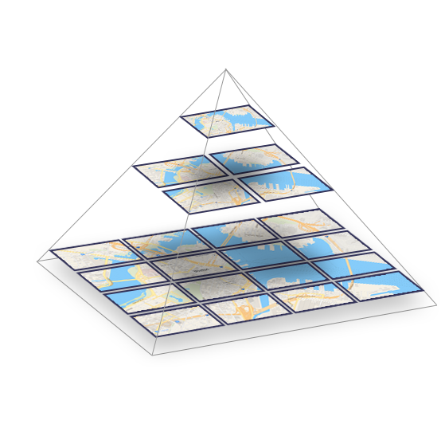
How do pan and zoom maps work?
Think of it as a tree
When zoomed far away, you are viewing an image of the map that is appropriate to that zoom level
As you zoom in, a new image is loaded
Shows appropriate details for that zoom level
Only shows the region of the map you are focusing on

Slide 11
How do pan and zoom maps work?
You need a source for ‘map tiles’
Esri
OpenStreetMaps
And a library (Leaflet) that communicates with the servers of these tiles
Give me a map tile
In a bounding box
At this zoom level
User interacts
Give me a new map tile…

Slide 12
How can we display data?
Suppose your data has latitude and longitude coordinates
We can’t just use d3 scales to determine how to go from data to pixel coordinate
We need to know what the coordinate space is of our current map tile

Slide 13
Steps
Ask for a ‘layer’ within the map drawing svg
Hand-off the placement of data points to the map library
Otherwise, we can mostly just do normal d3
Creating graphical primitives bound to data
Using color scales
Transitions, event handlers….
If you want positions or sizes or paths based on the map
Need to ask Leaflet
AND- need to create callback function for map zooming events, to redraw point positions

Slide 14
Let’s look at an example
Tutorial 10

Slide 15
And then let’s do an activity

